Slide 1



Plant Disease Detection
-ARYA RAUT

Slide 2

Learning Objectives
Understand how deep learning can be applied in agriculture.
Learn image classification using Convolutional Neural Networks (CNNs).
Gain hands-on experience with PyTorch and Flask integration.
Develop a real-time disease detection system for plant leaves.
Bridge the gap between AI research and real-world farmer support tools.
GOAL

Slide 3
Tools and Technology used
Programming Language: Python 3.8
Deep Learning Framework: PyTorch
Model Type: Convolutional Neural Network (CNN)
Dataset: Plant Village Dataset (39 leaf disease categories)
Backend Framework: Flask (for web app deployment)
Other Tools: Jupyter Notebook, OpenCV, Matplotlib, NumPy, Pandas

Slide 4
Methodology
Data Collection & Preprocessing
Used Plant Village dataset.
Image augmentation (rotation, flip, resize, normalization).
Model Development
CNN architecture designed in PyTorch.
Trained with multiple convolutional & pooling layers.
Optimized using Adam optimizer and Cross-Entropy loss.
Model Evaluation
Tested on unseen images.
Accuracy and confusion matrix analyzed.
Deployment
Flask-based web application.
Upload → Predict → Display Results.

Slide 5
Problem Statement:
Farmers often suffer from significant crop losses due to late or incorrect identification of plant diseases. Traditional methods of disease detection are manual, time-consuming, and require expert knowledge, which is not always easily available in rural or remote areas. Moreover, there is a lack of affordable, AI-powered tools that can assist farmers in diagnosing plant diseases quickly and accurately. This gap highlights the urgent need for a reliable and accessible technology-driven solution to support farmers in protecting their crops and improving agricultural productivity.

Slide 6
Solution:
Build a deep learning model trained on plant leaf images.
Classify plant diseases into 39 categories with high accuracy.
Provide a user-friendly interface where farmers can upload leaf images.
Display predicted disease name and suggest preventive measures.
Ensure scalability so it can be expanded for different crops in the future.

Slide 7
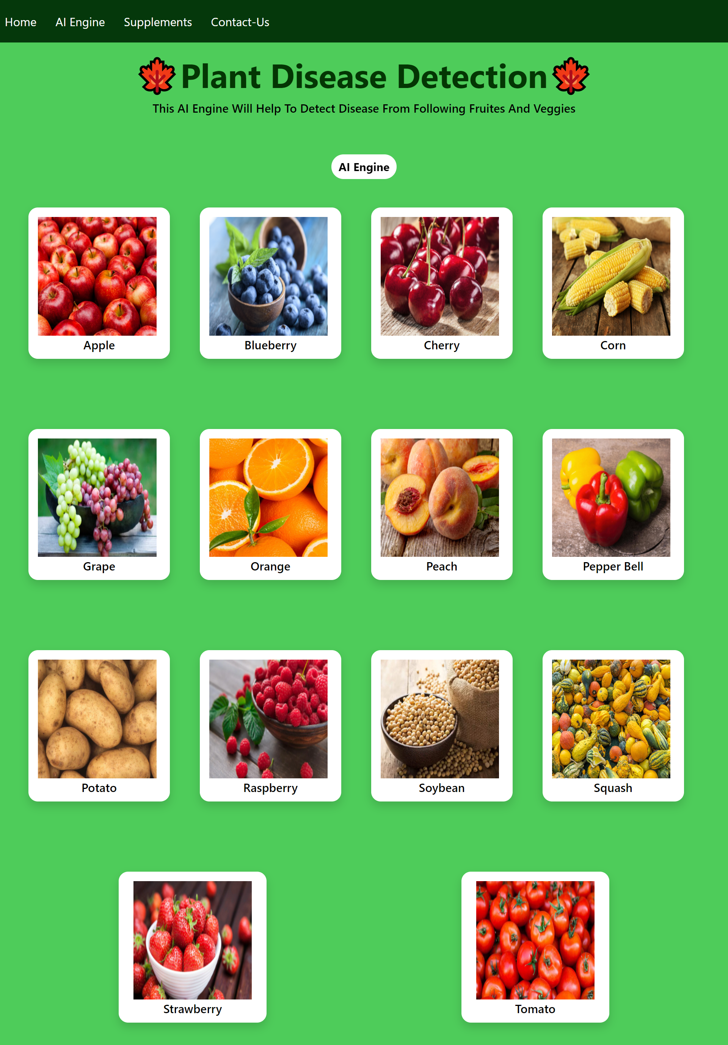
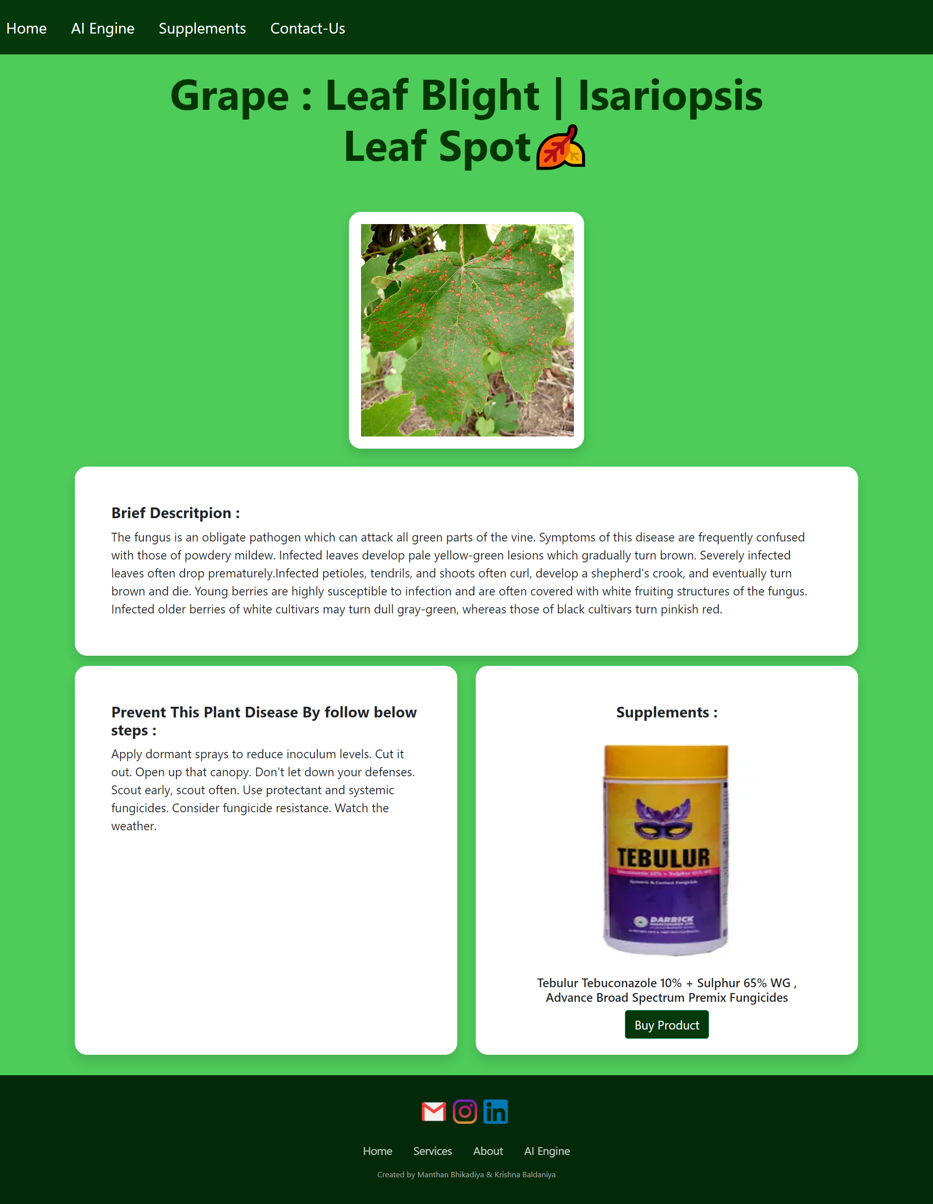
Screenshot of Output:

Slide 8
Conclusion:
In conclusion, this project successfully developed a Convolutional Neural Network (CNN)-based plant disease detection system capable of classifying leaf images into 39 different categories with high accuracy. The system demonstrates the potential of deep learning to provide a cost-effective, AI-powered solution that can assist farmers in diagnosing plant diseases quickly and reliably. By reducing dependency on manual inspection and expert intervention, the solution helps minimize crop losses and promotes healthier yields. Beyond its current form, the system can be further enhanced by integrating it with mobile applications and IoT-enabled sensors for real-time field monitoring, making it more accessible to farmers in rural and remote areas. Ultimately, this project contributes to the advancement of smart agriculture and plays a vital role in ensuring food security through the early detection and management of plant diseases.

